Slide 1
Introduction
Web development in nutshell
Tools for web development
Frontend vs Backend
Expectations vs reality
AI role into web development
What to expect from web development
Web development full flow

Slide 2

Web development in nutshell

Slide 3
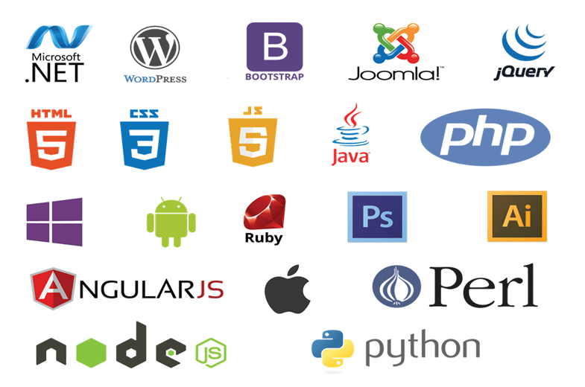
Tools for web development

Slide 4
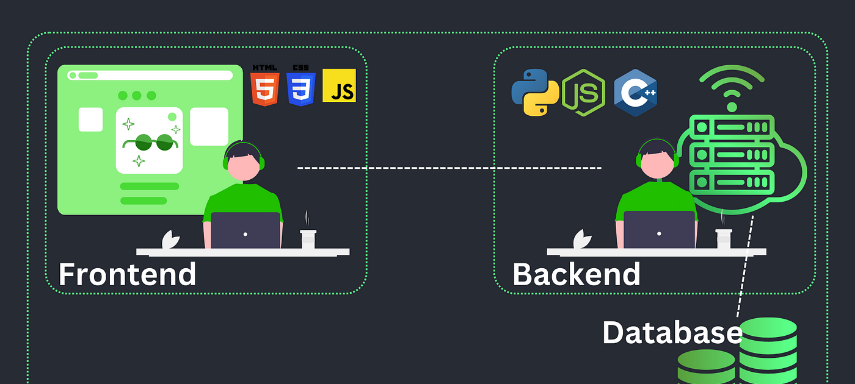
Frontend vs Backend

Slide 5

What can you expect
Expectations:
I’ll learn in 3 month
Most of my life will be writing code
When I learn react or angular I’m done
Reality:
The learning is infinity due to everything changes
Soft skills are important too

Slide 6

AI Role in web dev
Devs will be replaced?
Tool that will make developer faster?
Game changer in web dev?

Slide 7
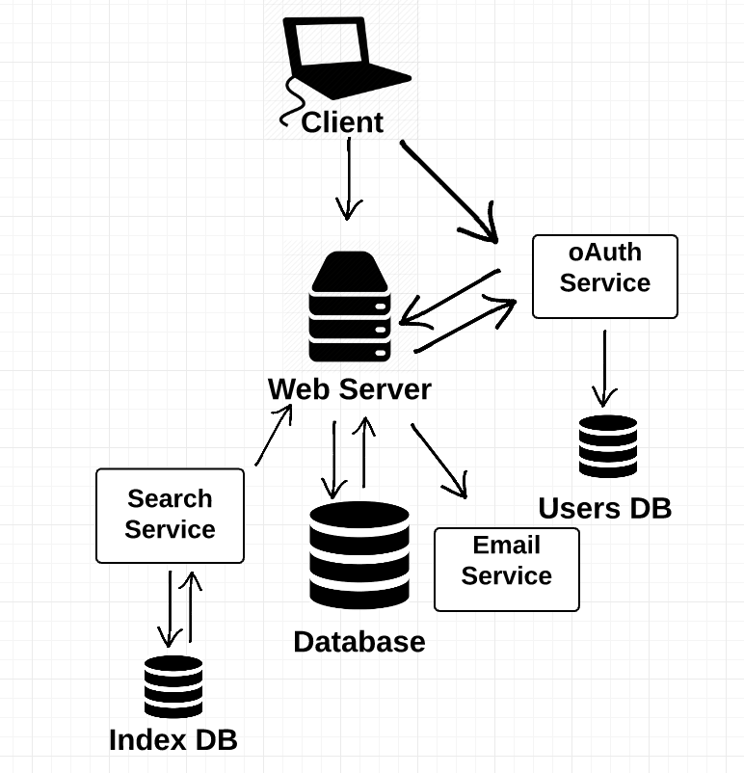
Web Development Flow

Slide 8
Lets make theory practice
Setup tools we need for this course
What is server & Simple demo how it works
How was code managed in old times
What is version control
Git essentials
Build first html page

Slide 9
Setup tools we need for this course
Git
Visual Studio / Any code editor
NodeJs

Slide 10
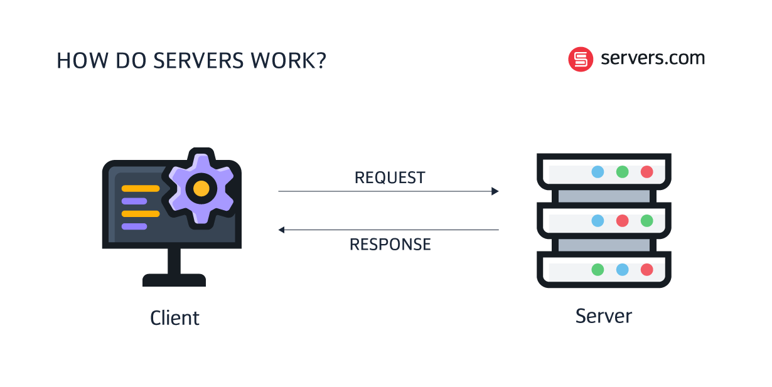
What is server

Slide 11
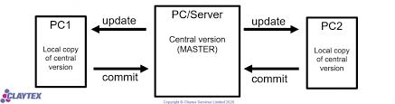
Good old times

Slide 12
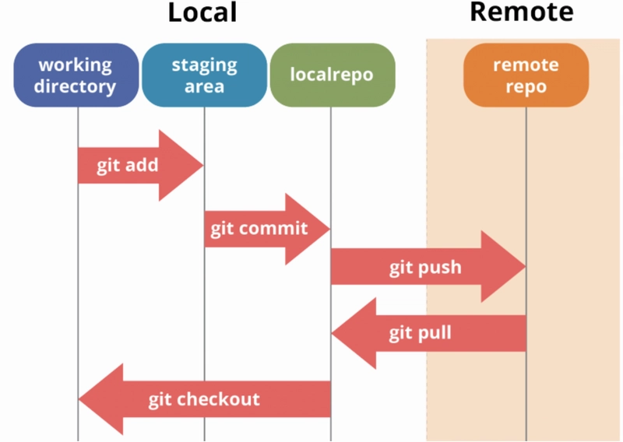
Version Control Systems (git)

Slide 13
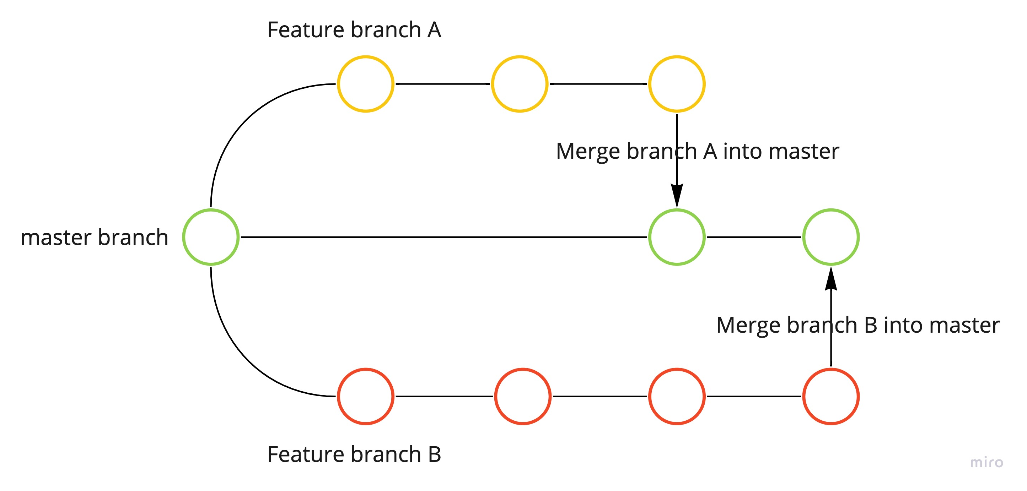
Git branch

Slide 14
Commands
Git branch
Git branch –a
Git checkout <branch_name>
Git checkout -b <branch_name>

Slide 15
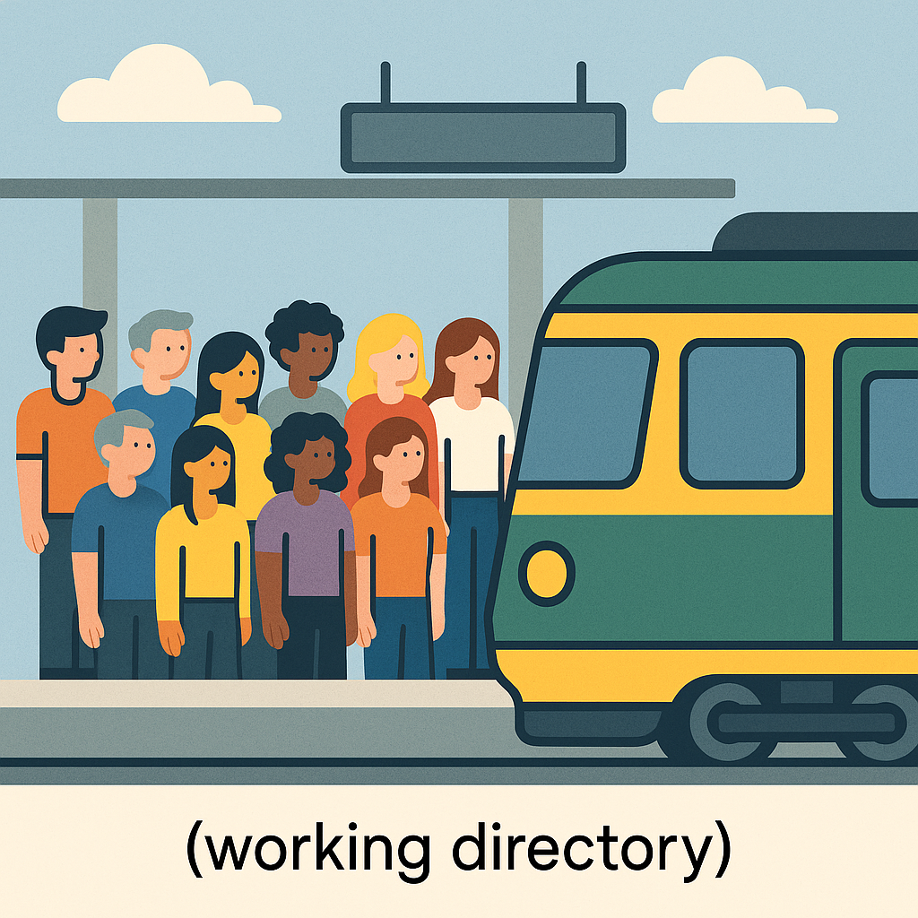
Working directory

Slide 16
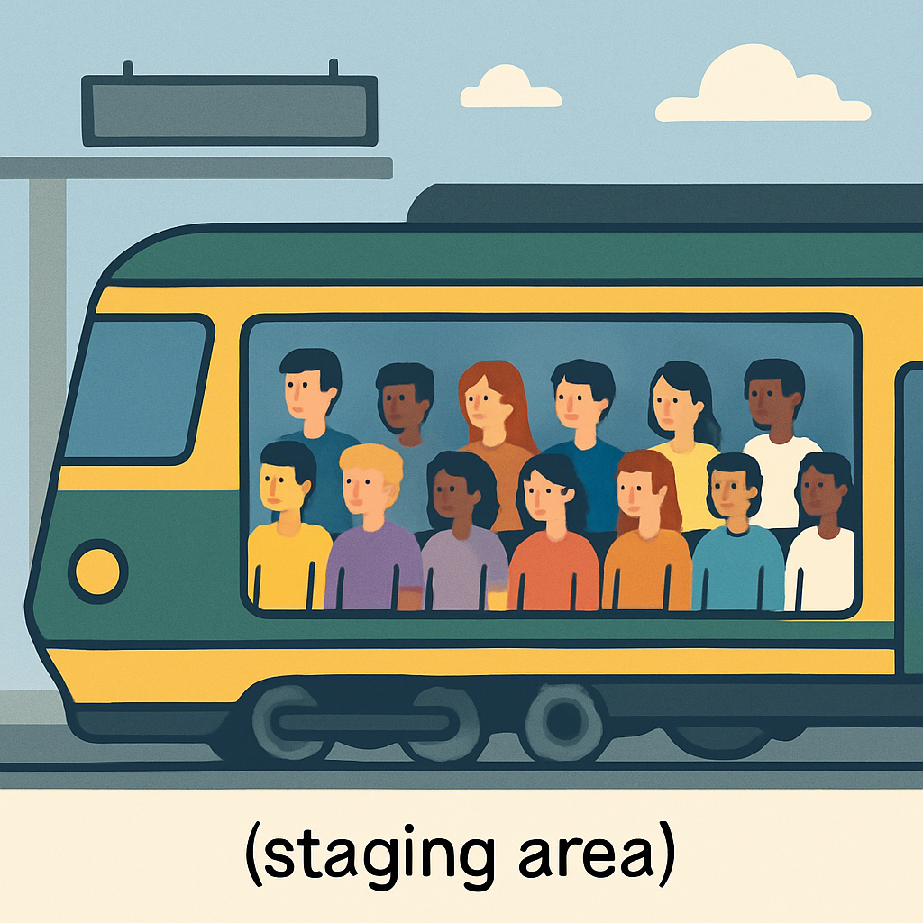
Staging Area

Slide 17
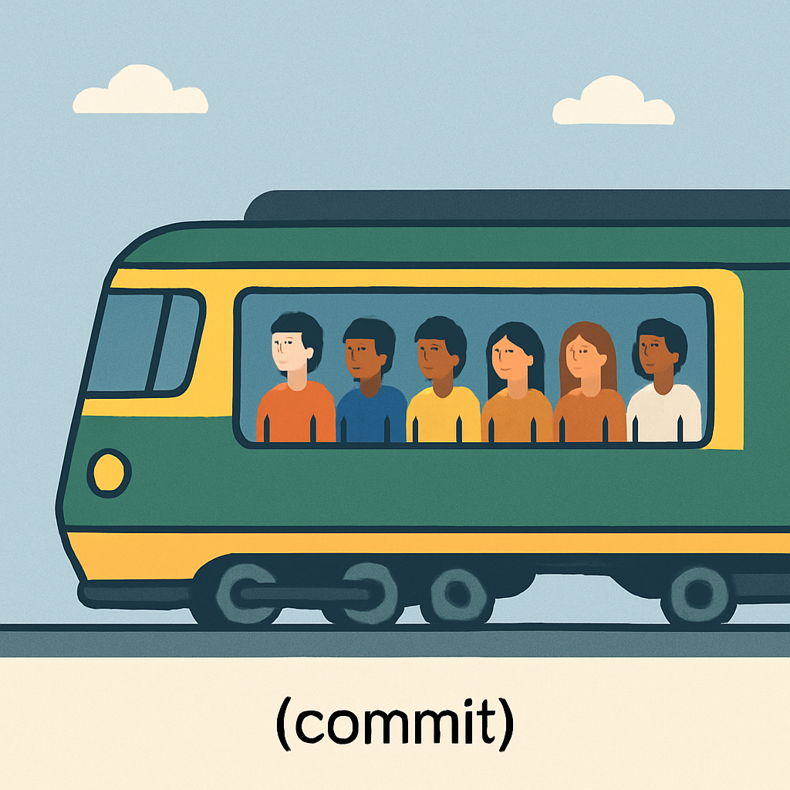
Commit

Slide 18
Commands
Git init – creates central station
Git push - sends train to central station ( that is connected to all of the users station )
Git pull – sends back the train from the central station
Git stash <file_name> - stashes the changes
Git commit –m <commit_message> - commits the changes
Git add . / Git add <file_name>

Slide 19
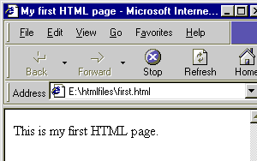
First HTML View

Slide 20
Follow Up Tasks:
Create simple html file. Init local repository and connect it to central github repo. Practise with commands we covered

Slide 21
Resources:
https://www.youtube.com/watch?v=Oaj3RBIoGFc

